Slide 1
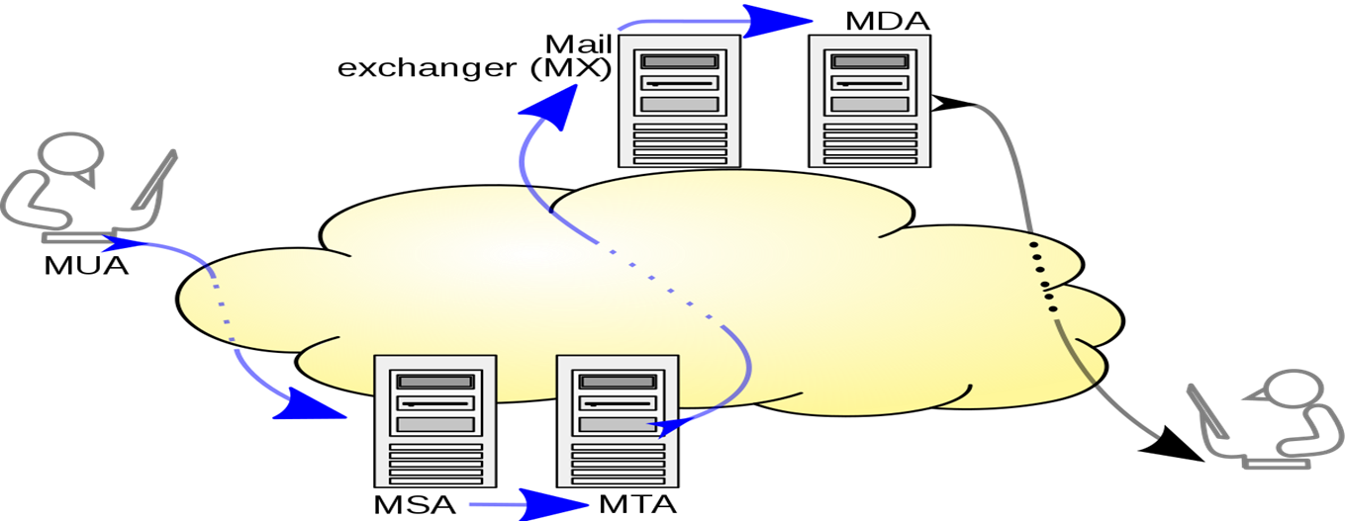
MDA / LDA
MDA is a Mail Delivery Agent (or) Message Delivery Agent and LDA is a Local Delivery Agent.
MDA is a computer software component that is responsible for the delivery of e-mail messages to a local recipient's(clients) mailbox.
Within a destination mail server, local MDA accepts an incoming email from remote MTA.
MDA’s do not transport messages between systems or interface only with the end user.
Delivers mail to other MTA.

Slide 2
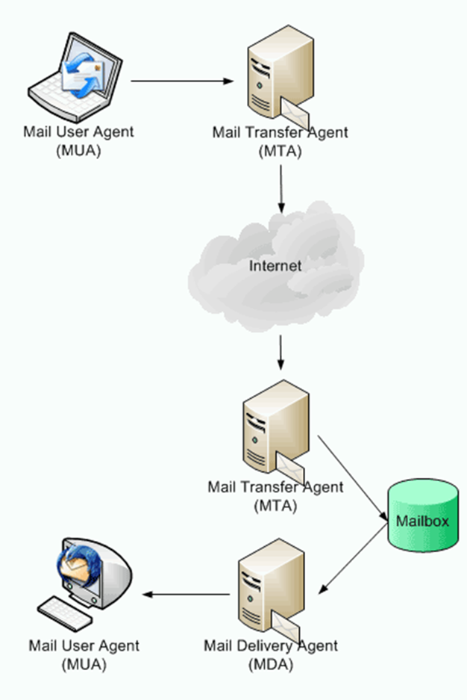
The recipient’s MTA receives the email and passes it on to a Mail Delivery Agent (MDA). An MDA manages the user’s mailbox and handles mails for delivery to the MUA using either the POP or IMAP protocol.
MDA Software
Procmail
Maildrop
Dovecot
Postfix
Cyrus

